Slide 1
Data Quality
TG3: Use Case Library
Miles Nicholls
Data Manager, Atlas of Living Australia
miles.nicholls@csiro.au

Slide 2
Context and purpose
The third task group of the GBIF TDWG biodiversity data quality interest group
Tasked to assemble a library of use cases describing specific examples of data selection

Slide 3
Anticipated Process
Use the framework from TG1 to understand the information that needs to be captured in a data quality use case
Create a model to store use case descriptions
Capture use cases
Analyse the use case elements
Cross reference the use cases against the tools from TG2
Identify areas for additional quality tools

Slide 4
Actual process
The first few steps were relatively straight forward:
Running through a few examples helped in understanding the practical application of the framework and led to the development of a use case description store – a series of related worksheets to capture a use case:
Sheets that collect the elements from the framework: Use Case Title, Information Elements, Data Quality Dimensions, Data Quality Criteria and Data Quality Enhancements
Allan Koch Veiga added a DQ profile tool which produces a report based on the information in the worksheets

Slide 5
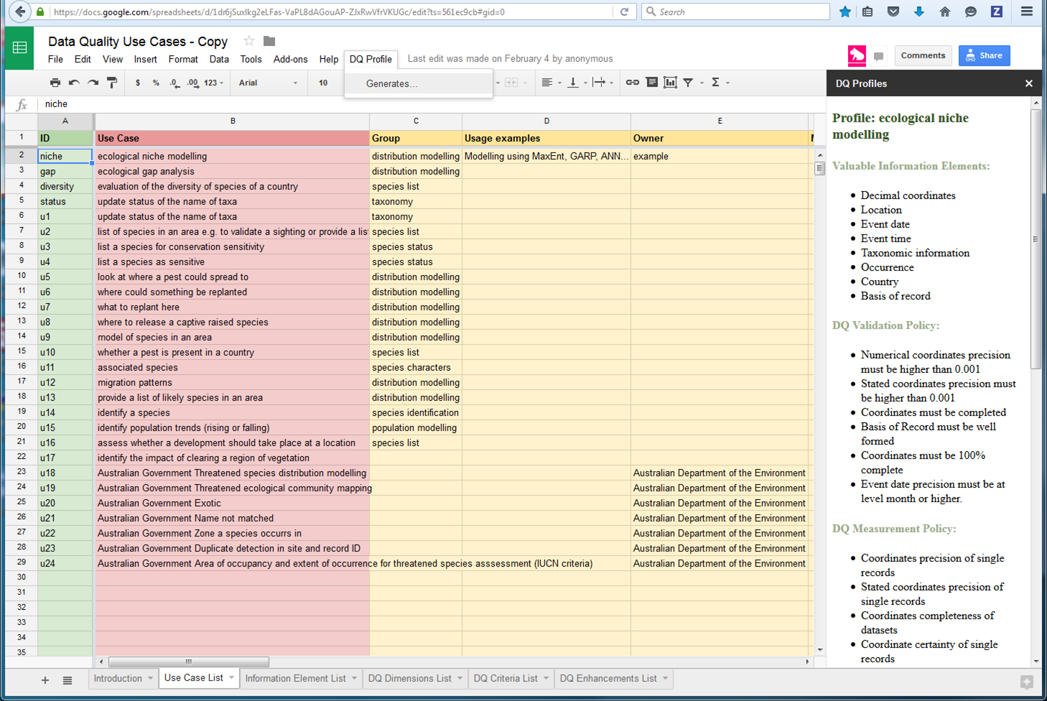
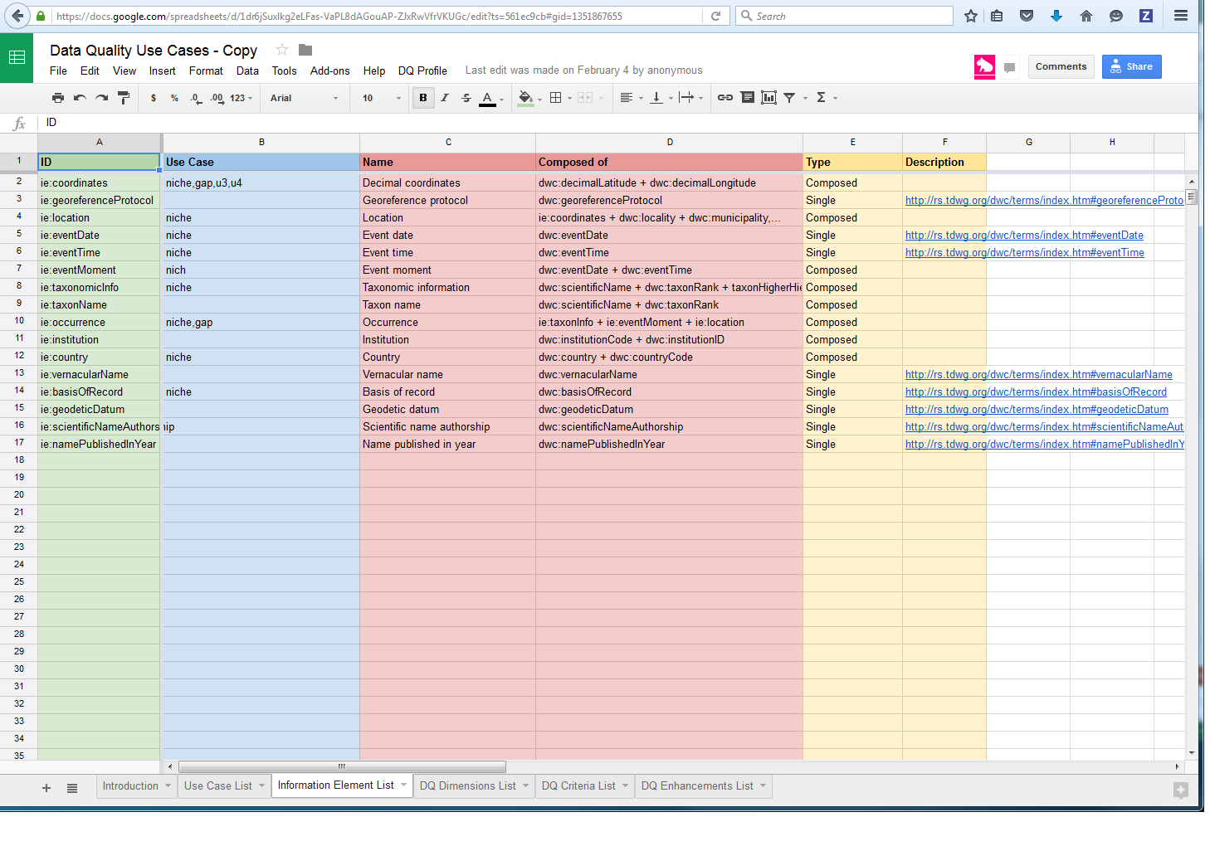
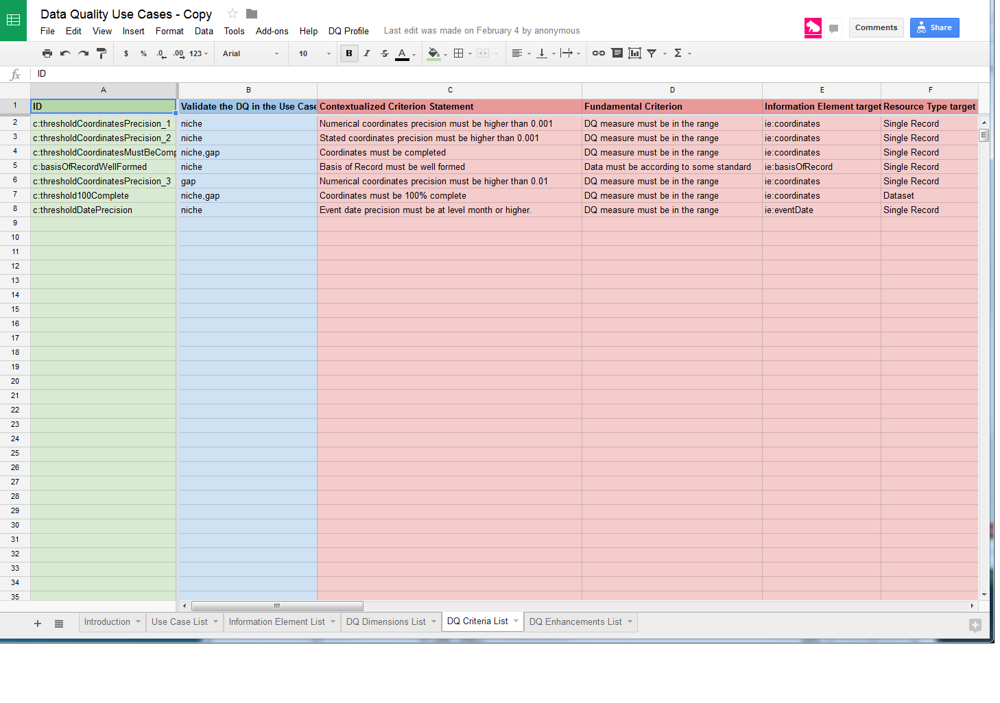
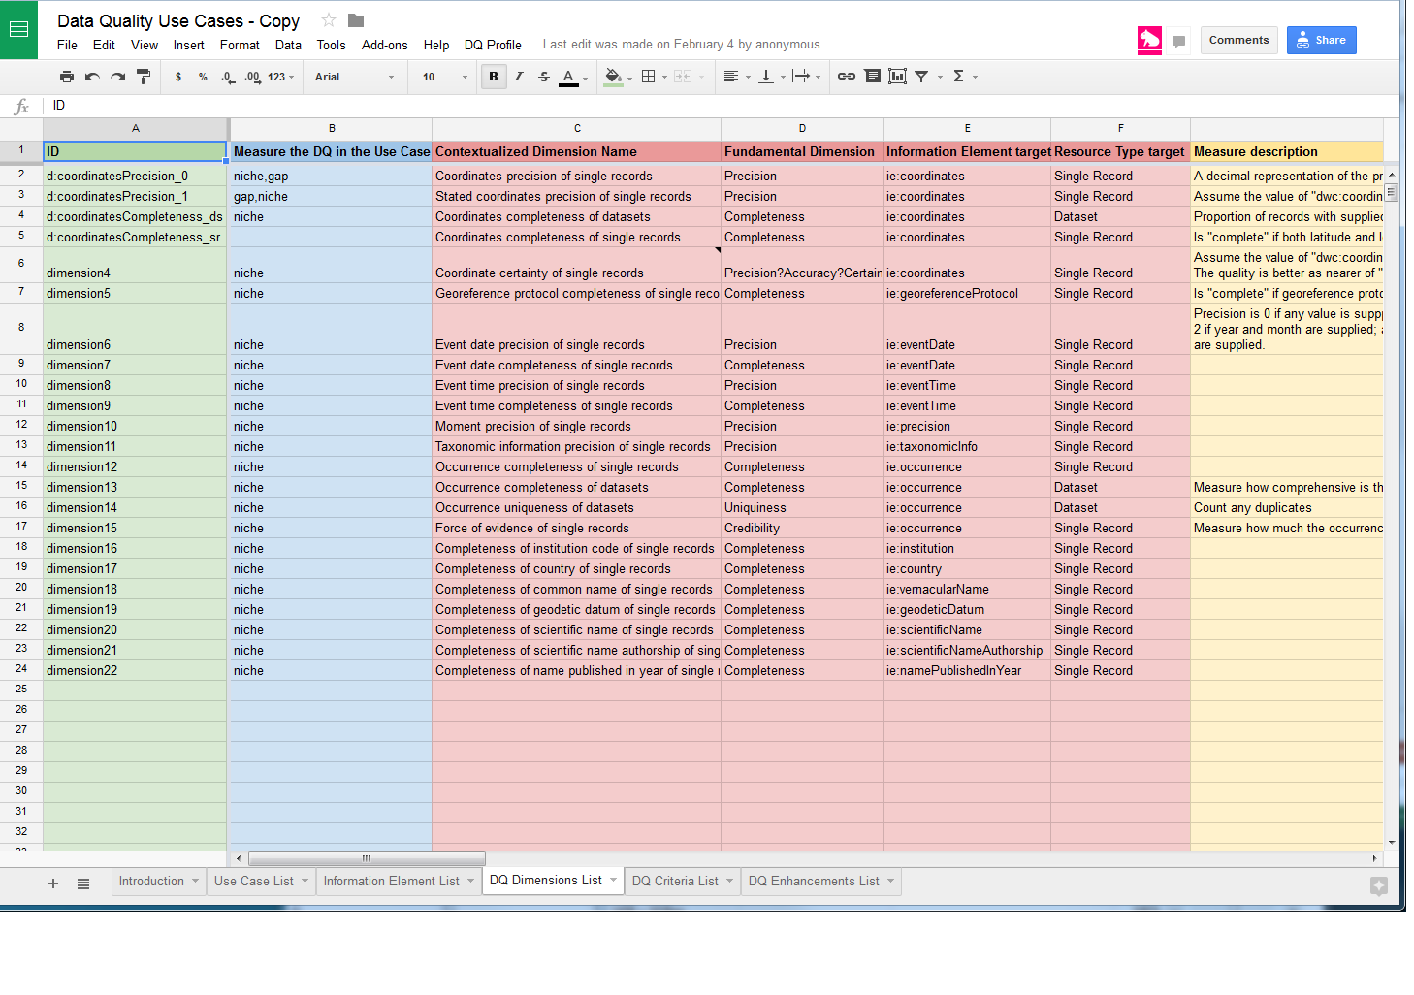
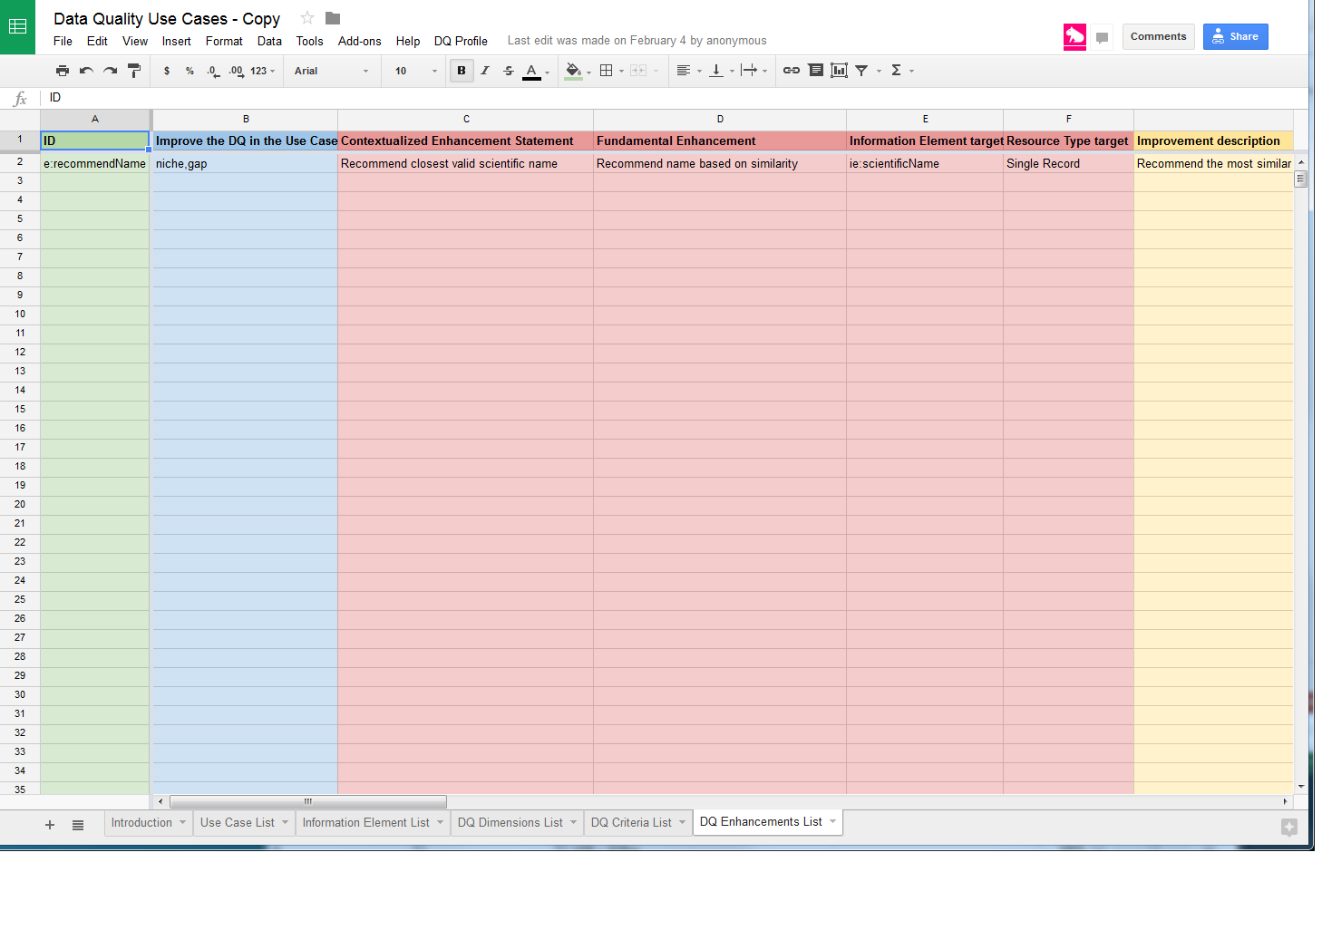

Slide 6
Actual process
Review of the initial worksheets indicated that although it collected the required information the level of technical understanding required to fill in the series of related sheets was likely too high for it to be widely used.
That the worksheets were online and didn’t export well was also a barrier to data entry
So an additional offline sheet was developed focussed on capturing a single use case as simply as possible

Slide 7
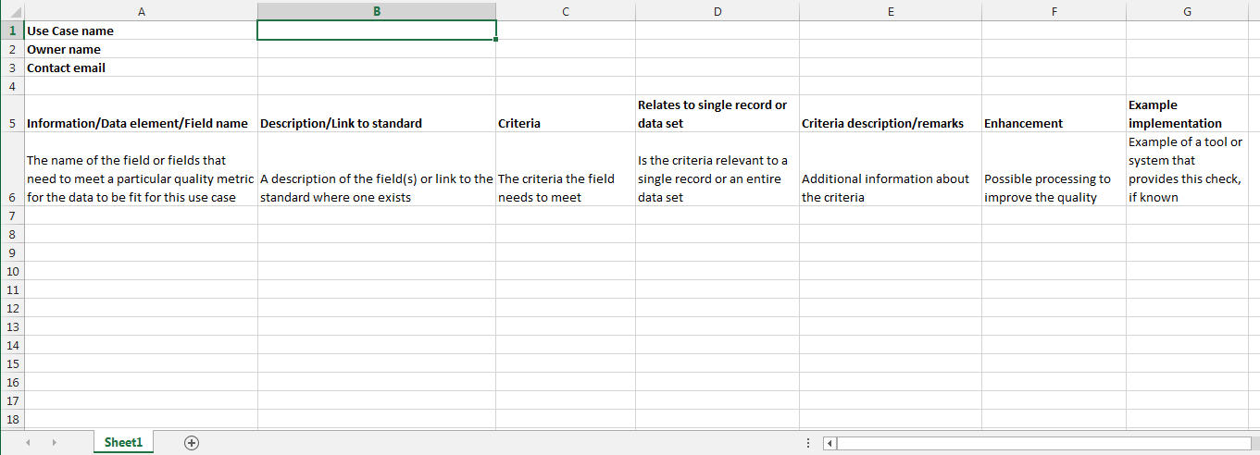
Once the template was filled in it would be converted to the more complex data structure manually

Slide 8
Actual Process
The template was then posted up on the GBIF community site with some help material, a worked example and a request for contributions
…
A further post was added to indicate that an email with a text description would be enough to start the process
…

Slide 9
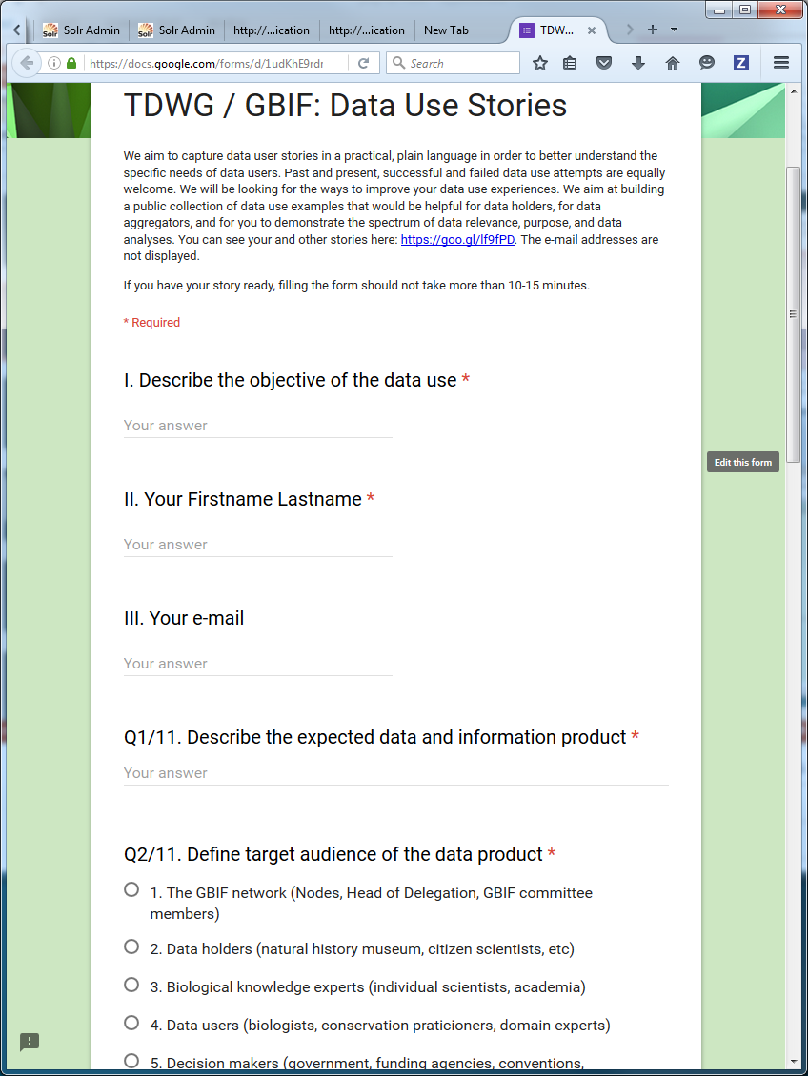
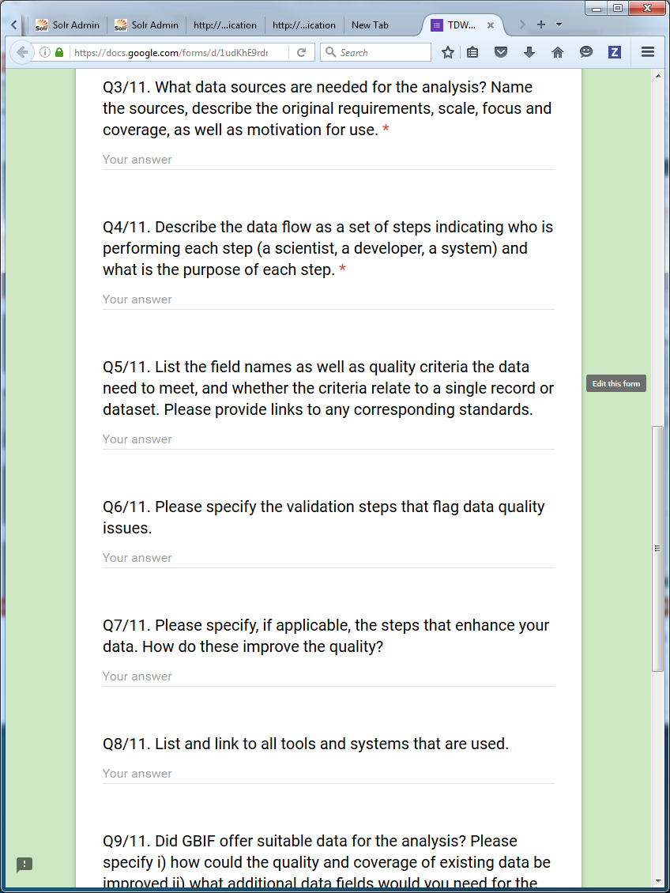
A new use case collection template
There was almost no use of the templates so following on from the meeting in Sao Paulo a further simplified form was developed as a Google form by Dmity Schigel
https://docs.google.com/forms/d/1udKhE9rdr2txkDE8MiBK-wHHVbr4G5mcdktq6P3rFXk/viewform

Slide 10
Progress to date
Unfortunately very few use cases have been submitted

Slide 11
Key challenge so far
How to address the limited number of contributions:
The Atlas of Living Australia has brought in a student to actively pursue documentation of use cases for 2 months
They will be increasing the amount of communication on the task group and the tools developed to collect use cases
Directly working with the community to document use cases
Gathering feedback on the proposed tools and their usability
If you have use cases or can offer possible sources of use cases (including papers, reports and tools) please contact Emilyrose.Rees@csiro.au

Slide 12
What’s next
Continue to collect use cases
Improve communication
Publicise contributions
Transfer use cases to the use case store
Improve use case collection tools based on feedback

Slide 13
The future
Encourage use of the use case library as a resource to research how data is selected for particular purposes
Begin to build profiles of the most used information elements, dimensions and criteria
Feed these back to tools and initiatives that collect data
Feedback use cases into the development of data quality assessment tools
Begin to develop automated data selection for use cases

Slide 14
Thank You
Do you have a data quality use case?
Task Group 3 - Use Case Library for Data Quality

